Slide 1
CSS Selectors: Select by ID

Slide 2
Recap

Slide 3
General Format for CSS Rule
selector {
property: value;
property: value;
…(as many declarations as you want)
}

Slide 4
CSS Selectors
selector {
property: value;
property: value;
…(as many declarations as you want)
}
The selector defines which HTML elements this rule applies to

Slide 5
Select by tag
h1 {
font-size: 60px;
color: red;
}
This rule applies to all <h1> elements

Slide 6
Select by Class
.alert {
font-size: 60px;
color: red;
}
This rule applies to all HTML elements with the class “alert”

Slide 7
NEW: Select by ID
#logo {
font-size: 60px;
color: red;
}
This rule applies to the single HTML element with the id “logo”

Slide 8
The id attribute
id is an attribute we can add to an HTML tag to style that specific element.

Slide 9
The ID Attribute
<h1>CodeHS</h1>

Slide 10
The ID Attribute
<h1 id=“logo”>CodeHS</h1>
This sets the id attribute of the <h1> tag to be “logo”

Slide 11
The ID Attribute
<h1 id=“logo”>CodeHS</h1>
This sets the id attribute of the <h1> tag to be “logo”
The id of an element should be unique.
There should be only one tag with a given id on any web page.

Slide 12
Select by ID
#logo {
font-size: 60px;
color: red;
}
This rule applies to the single HTML element with the id “logo”

Slide 13
Select by ID
#logo {
font-size: 60px;
color: red;
}
The id is preceded by a hashtag (#)

Slide 14
Select by ID
#logo {
font-size: 60px;
color: red;
}
The HTML element with the id “logo” will have a font size of 60px and will be red

Slide 15
ID names
Cannot have spaces
Cannot start with a number

Slide 16
ID names
id=“2logo”
id=“large logo”

Slide 17

ID names
id=“2logo”
id=“large logo”

Slide 18
ID names
id=“logo2”
id=“large-logo”

Slide 19

ID names
id=“logo2”
id=“large-logo”

Slide 20
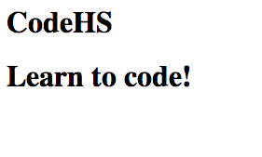
Example: Style the Logo
<h1 id=“logo”>CodeHS</h1>
<h1>Learn to Code!</h1>

Slide 21
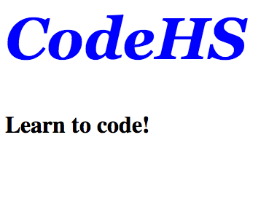
Example: Style the Logo
<style>
#logo {
font-family: Georgia;
font-size: 80px;
font-style: italic;
color: blue;
}
</style>
<h1 id=“logo”>CodeHS</h1>
<h1>Learn to Code!</h1>

Slide 22
ID overrides Class and Tag
id style overrides both class and tag style in the case of a conflict
id is the most specific type of style
Select by Tag Select by Class Select by ID
Least specific
Most specific

Slide 23
Example ID style override
<style>
p {
color: green;
}
.alert {
color: red;
}
#logo {
color: blue;
}
</style>

Slide 24
Example ID style override
<style>
p {
color: green;
}
.alert {
color: red;
}
#logo {
color: blue;
}
</style>
<p>Hello</p>
What color will this element be??

Slide 25
Example ID style override
<style>
p {
color: green;
}
.alert {
color: red;
}
#logo {
color: blue;
}
</style>
<p>Hello</p>
Hello

Slide 26
Example ID style override
<style>
p {
color: green;
}
.alert {
color: red;
}
#logo {
color: blue;
}
</style>
<p class=“alert”>Hello</p>
???

Slide 27
Example ID style override
<style>
p {
color: green;
}
.alert {
color: red;
}
#logo {
color: blue;
}
</style>
<p class=“alert”>Hello</p>
Hello

Slide 28
Example ID style override
<style>
p {
color: green;
}
.alert {
color: red;
}
#logo {
color: blue;
}
</style>
<p class=“alert”>Hello</p>
Hello
class style overrides tag style

Slide 29
Example ID style override
<style>
p {
color: green;
}
.alert {
color: red;
}
#logo {
color: blue;
}
</style>
<p class=“alert” id=“logo”>Hello</p>
???

Slide 30
Example ID style override
<style>
p {
color: green;
}
.alert {
color: red;
}
#logo {
color: blue;
}
</style>
<p class=“alert” id=“logo”>Hello</p>
Hello
id style overrides both tag style and class style

Slide 31
Example: no style conflicts
<style>
p {
color: green;
}
.alert {
font-size: 60px;
}
#logo {
font-style: italic;
}
</style>
<p class=“alert” id=“logo”>Hello</p>
Hello
If there are no conflicts, all 3 styles will apply!

Slide 32
Let’s see this in the editor!

